Slide 1
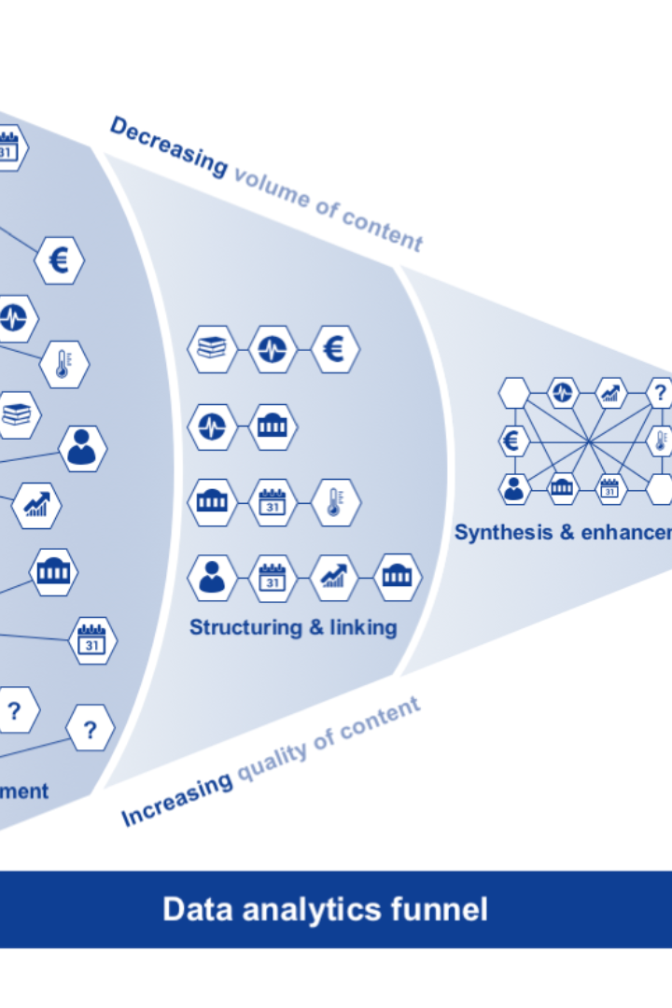

Building a Big Data Analysis Solution with IBM Cloud Databases
Unlock the power of big data analysis with IBM Cloud Databases. In this presentation, we will guide you through the process of setting up a database instance, exploring and analyzing datasets, and performing data cleaning and transformation.
AR
by Ahmed Riyas kaan

Slide 2

IBM Cloud Account Setup
1
Create an Account
2
Choose Database Service
3
Set up Database Instance
Start by creating an IBM Cloud account to get access to a wide range of services and tools.
Select the most suitable database service for your data analysis needs, such as Db2 or MongoDB.
Create an instance of the selected database service to store and manage your datasets.

Slide 3
Exploring and Analyzing Selected Dataset
1
Data Exploration
Use advanced querying techniques to dig deep into your dataset and gain valuable insights.
Data Analysis
2
Apply statistical methods and machine learning algorithms to uncover patterns and trends in your data.
3
Visualize Results
Create compelling visualizations to effectively communicate your findings to stakeholders.

Slide 4
Developing Queries and Scripts
Structured Query Language (SQL)
Scripting Languages
Harness the power of SQL to retrieve, manipulate, and analyze data stored in your IBM Cloud Databases.
Utilize scripting languages like Python or R to automate complex data analysis tasks and build sophisticated models.

Slide 5
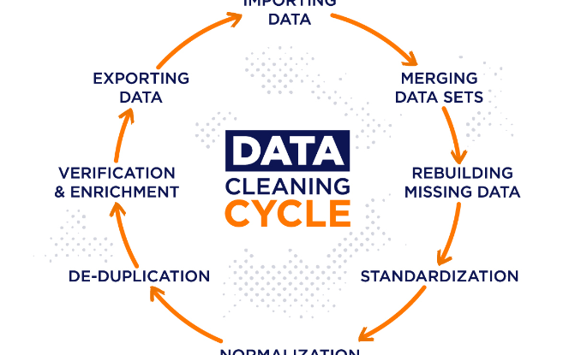
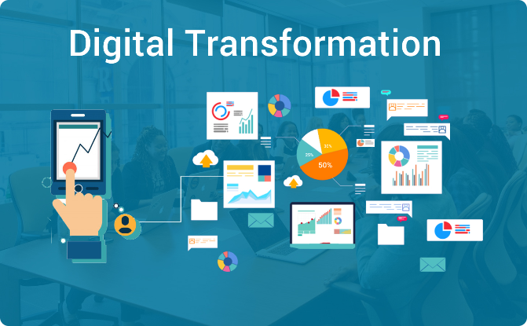
Basic Data Cleaning and Transformation
Data Cleaning
Data Transformation
Identify and handle missing values, outliers, and inconsistencies in your dataset to ensure data quality.
Apply transformations such as normalization, aggregation, and feature engineering to prepare your data for analysis.

Slide 6
Conclusion and Next Steps
Draw Insights
Optimize Performance
Continual Learning
Summarize key findings from your analysis and identify actionable insights to drive informed decision-making.
Fine-tune your queries, scripts, and database configurations to improve analysis speed and efficiency.
Stay updated with the latest advancements in big data analysis and explore additional features offered by IBM Cloud Databases.

